Slide 1
Microservices and DevOps
DevOps and Container Technology
Design for Deployment
Henrik Bærbak Christensen

Slide 2
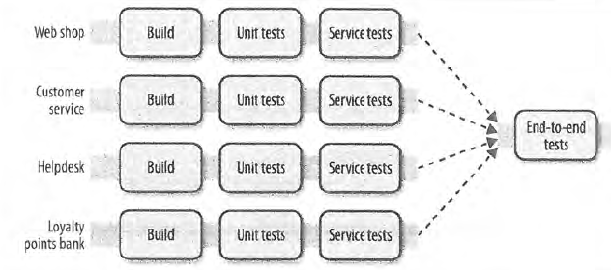
Motivation
Continuous Delivery of Services
Individual versions of services, combined into full system
v231
v198
v534
v54
v55
Easy? Edit composefile, and ‘docker stack deploy’. Right?

Slide 3
Motivation
Co-existence of versions of services
During deployment (horizontally scaled)
Assumptions on version of interfaces between services
v231
v198
v534
v54
v55

Slide 4
Rollout takes time
Full Deployment phases
Preparation
Rollout N applications
Cleanup
Each Application Rollout, again contains phases
Preparation
Drain Stop new request, await pending processed
Update Deploy new application
Startup Loading, Warm up caches, state resynch
That is, multiple versions co-exist in production ☹

Slide 5
Simple Example
EcoSense MongoDB replica set disk size expansion
(ended at 3 x 6 TeraBytes)
For three instances do:
Drain: Shutdown db server
If Primary, await new primary promoted
LVM magic to extend size (manual process, takes 1-3 minutes)
Update: Start db server
Startup: Await replica status shows server is ‘uptodate’
(Bass ‘State resynch’ finished)

Slide 6
Issues
Versions differ on several aspects
(Rest/Web) APIs
(Nygard §14 / We will return in second course ‘versioning’)
Robustness Principle: Be conservative in what you do, be liberal in what you accept from others. [Jon Postel]
Database schemas
Web assets

Slide 7
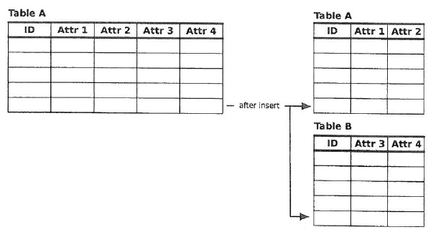
Database Migration: SQL
Shim: Bit of code that helps join the old and new version of application.
Triggers on UPDATE, INSERT, DELETE that update in both directions
Version v54
Version v55

Slide 8
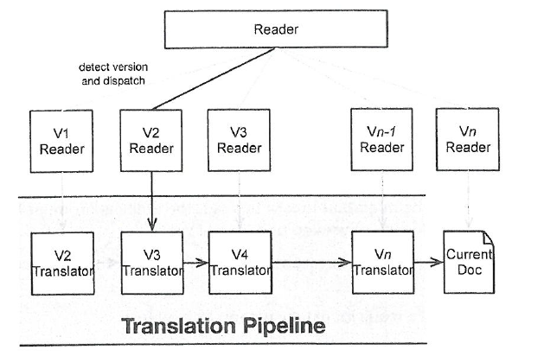
Migration: NoSQL
Schema-less? Hah! Applications expect schemas!
Translation pipeline: Code the reader so it can read all versions ever made.
Corollary: Always include version identity in documents!
Keep old data around to test the translations
v2 -> v3; v3 –> v4; etc.
Liability:
Deep pipeline (slow)
Cumbersome code
Db contents highly mixed

Slide 9
Migration
Approach two
Migration routine: Run a special schema lifting process during deployment, after all instances have been updated
Liability
Big data means hours spent on migration => Planned downtime
Why instance update before migration routine?
Consider old version instance reads from new format db
Cascading failure…

Slide 10
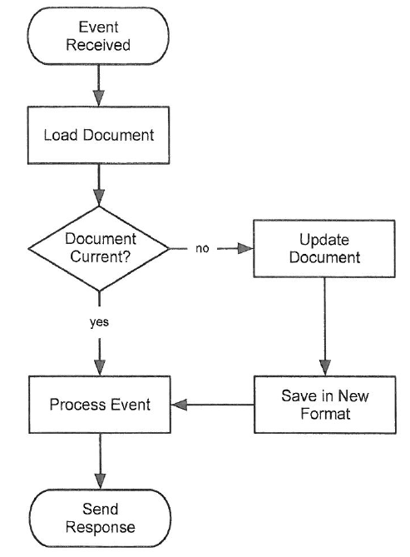
Migration
Approach three (Nygard’s favorite)
Trickle, then batch: Initiate migration as they are touched (conditional code in the application code). After some time (at least all instances are updated), perform a batch migration routine on all documents not converted. Finally, conditional code can be removed (final update).

Slide 11
Migration
Benefits
Migration time is amortized (no downtime)
Batch can run concurrently in production
Only one version in DB (eventually ☺)
Clean code (no translation pipeline; no conditional code; eventually ☺)
Liabilities
Complex deployment setup
Two application updates for all apps that read that kind of document
v_n: with trickle code; v_n+1: trickle code removed

Slide 12
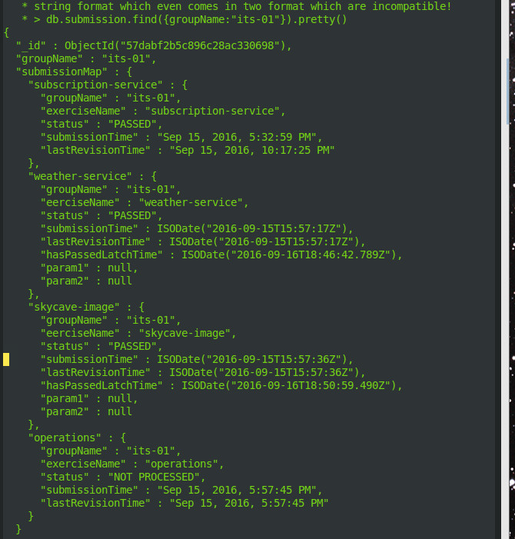
Example
From my own, small-scale, backyard
Crunch3: Predecessor for ‘your Crunch’
Date’s were generated by GSON library
And they s…., as
Plain text in two different incompatible formats
UTC or EST or ?
Migrate to ISO8601
Always use ISO8601 strings !!!

Slide 13
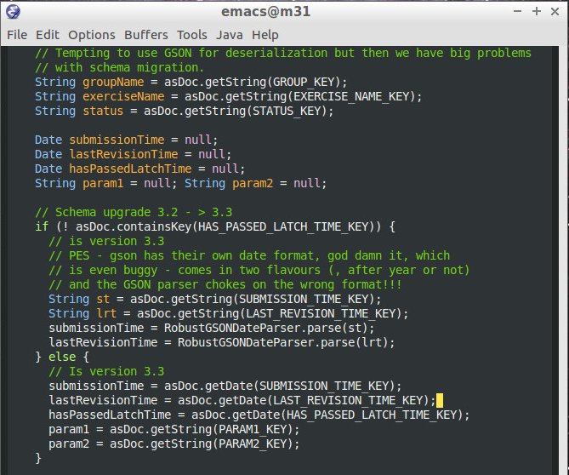
Fear of ‘Oh-No’ seconds…
Even buggy comment ☹
Trickle, without the batch ☺
Notes:
[Skycave-services, 16/9 2016 MongoSubmissionService.java]. I had the conditional in code, and wrote stuff back, but there were no batch process that change non-converted items.

Slide 14
Web assets
The issue:
Web UI’s contains static assets (stylesheets, java script, images, …)
Web browsers cache these assets
Thank god, so server load is minimized
Usually there is a hard coupling between UI elements and server side
So, when we update the server, we must force the browser to ‘bust the cache’ and fetch all assets afresh!
Tips and trick – see Nygard ☺

Slide 15
Rollout Techniques
Birds, colors, and more…

Slide 16
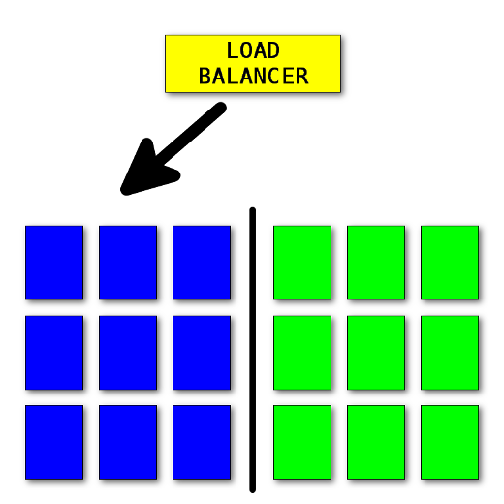
Blue/Green Deployments
Algorithm
Deploy v N+1
Smoke test
Swich load
Monitor!
Benefit
Rollback is easy
Liability
2x HW cost!
Common DB ???
Notes:
https://opensource.com/article/17/5/colorful-deployments

Slide 17
Release Vrs Deploy
Blue/Green embody the distinction between release and deploy
Deploy vN+1 but Release is vN
Notes:
https://opensource.com/article/17/5/colorful-deployments

Slide 18
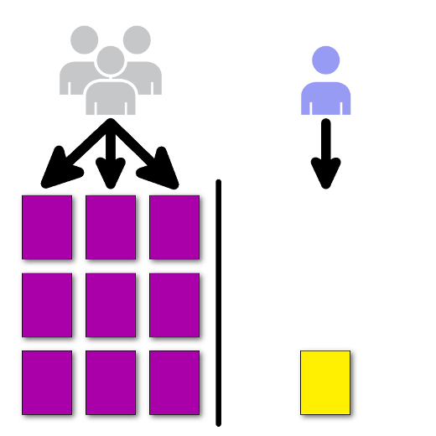
Canary Deployment
Algorithm
Direct d% traffic to version n+1
Monitor
If OK, direct (d+20)% traffic to it
Benefits
Scientific experimentation!
Lower HW costs
Easy rollback
Liabilities
Complex setup

Slide 19

Rolling Deployment
Algorithm
One-by-one
Benefits
Constant HW
Liability
Complexity

Slide 20
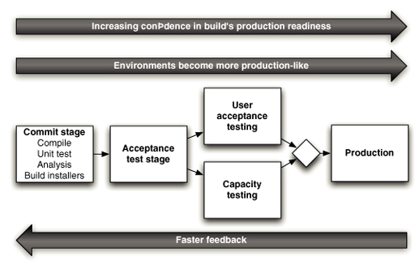
Humble:
Commit stage
Asserts technical level
Build + Unit tests
Accept test stage
System works at functional and non-functional level
Meets demand of users
Manual test stages
UAT
Release stage
Deliver system to users
A manual go/no-go ?
Notes:
P108 in Continuous Delivery

Slide 21
Monitoring
Rollout depends deeply on monitoring…
Overview the machines and overview the services
We will return to that in course two…

Slide 22
Nygard
Nygard provides more detail in the rollout phase than Newman ☺
”Canary release, yes, but hey – what if the canaries migrates the shared database schema ???”
”What if requests gets load-balanced to (new, old, new, old, new) version instances?
The rollout phases
Drain, update, startup
Important: monitor after each phase

Slide 23
Sessions
If you do blue/green deployments
What happens to open connections when the load balancer switches from the blue to the green cluster?
If you do canary or rolling deployments
What happens if you hit an old version instance that tries to access new database schema documents?

Slide 24
Session Stickiness
You must avoid hitting new/old instances as they co-exists
Sticky sessions: All requests from a given session is routed to the same server
Or perhaps ‘same version of server’
Alternatives
Session database: Session data is stored in session database, shared by all servers
Client sessions (browser cookies): Session data is stored in client, sent with each request

Slide 25
Co-existing Versions
If you have (old/new) version applications co-existing
Which is a consequence of no-down-time continuous delivery ☺
Then you have to ensure session stickiness
To avoid (new) version request put an Order object (new format) into the DB, and next a (old) version request read it expecting the old format
But
What is the big issue with session stickiness?
Notes:
Answer: You have just sacrificed your redundancy – there is no bulkheading. If server n crashes, all clients stuck with server n cannot be serviced!

Slide 26
Cleanup
Monitor hard ☺
If everything looks OK, then cleanup
Remove shims, drop tables, initiate then-batch of trickle-then-batch, remove trickle code (new version, then new ‘delivery’)

Slide 27
Summary
Nygard digs that one step deeper into real issues !
Lots of code near techniques must be employed in order to make CD work in practice…
Characterization of the process
Preparation, Rollout N, Cleanup
Preparation, Drain, Update, Startup
Tactics for state migration
Translation pipeline, Migration process, Trickle-then-batch
Issues in Deployment Rollout
(Temporary?) Session stickiness a bit vague there…

